Slide 1
Project
diamond price prediction
Lan Dao
2025 April 25

Slide 2
table of
CONTENT
I. data understanding and visualizations
III. data exploration and preprocessing impact
II. baseline model
IV. feature engineering and preparation for ML
V. Advanced regression model

Slide 3
OBJECTIVE
RESEARCH QUEATIONS
1. Which regression models are most effective for predicting the diamond prices ?
2. How do preprocessing steps impact on model performance ?
Build a predictive model that accurately estimates the price of diamonds based on various features

Slide 4
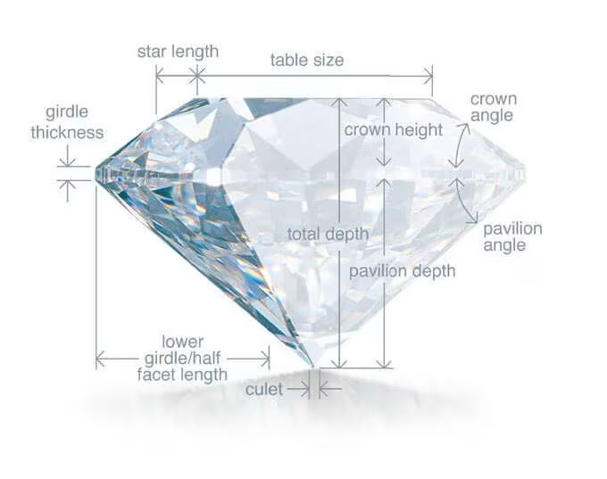
Background
INFORMATION
Carat: (0.2 -> 5.01)
Cut: (Fair < Good < Very Good < Premium < Ideal)
Color: ( J (Worse) < D (Best) )
Clarity: (I1 (Worst), SI2, SI1, VS2, VS1, VVS2, VVS1, IF (Best))
Table: width of the top of the diamond relative to widest point

Slide 5
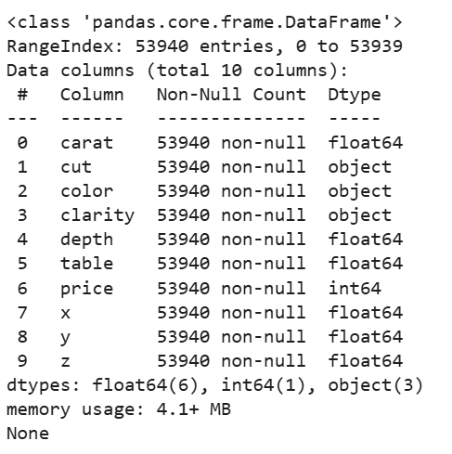
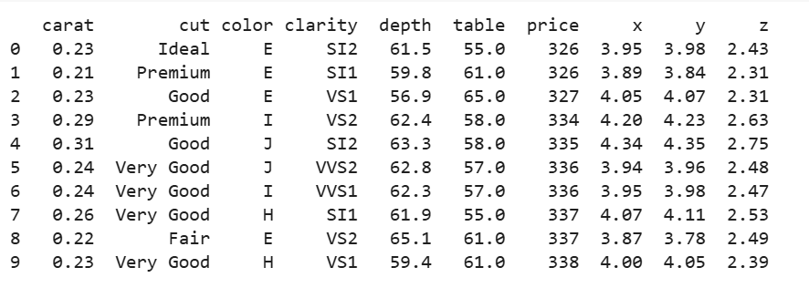
Data Understanding
VISUALIZATIONS
Dataset overview
Data Information

Slide 6
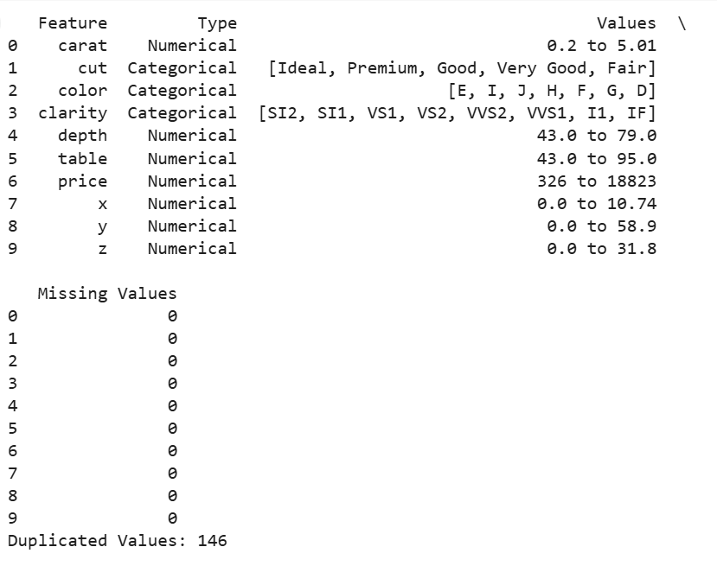
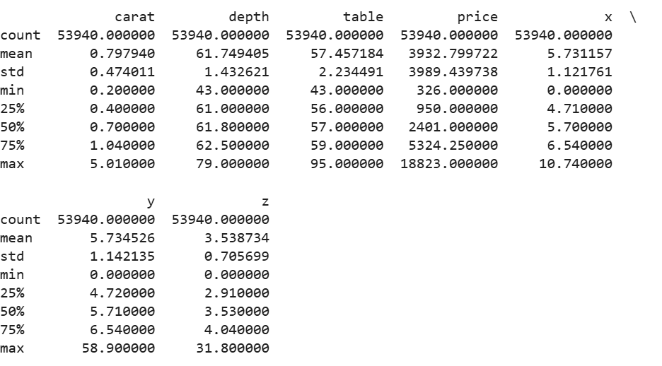
Data Describe
Features Summary

Slide 7
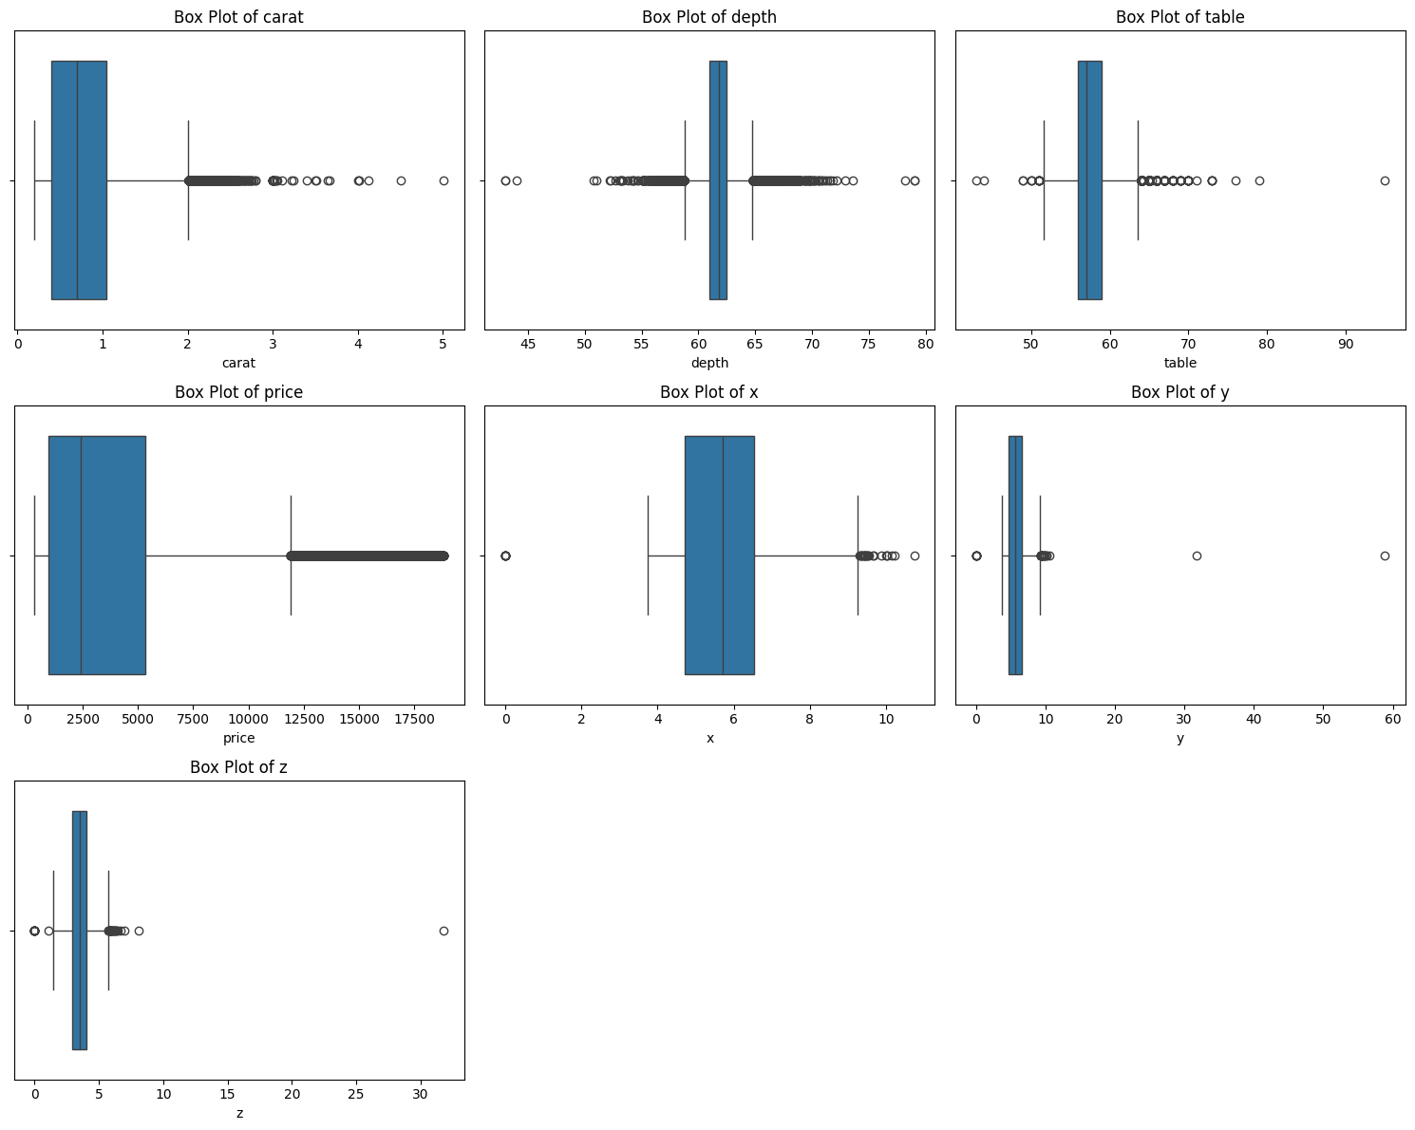
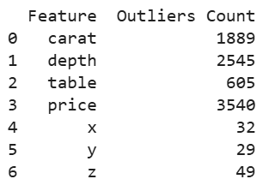
Outliers Count & Detection

Slide 8
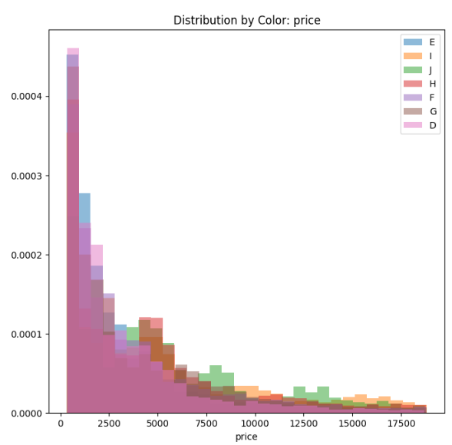
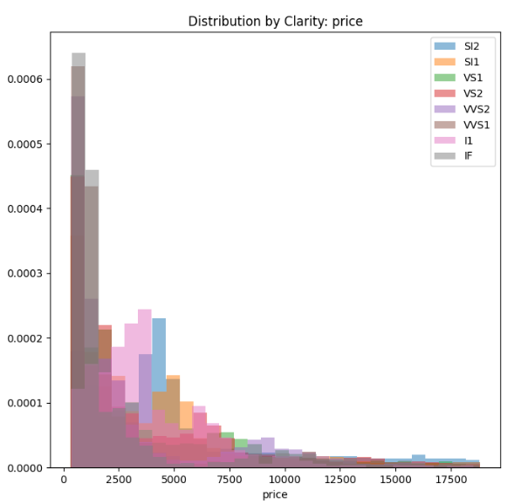

Slide 9
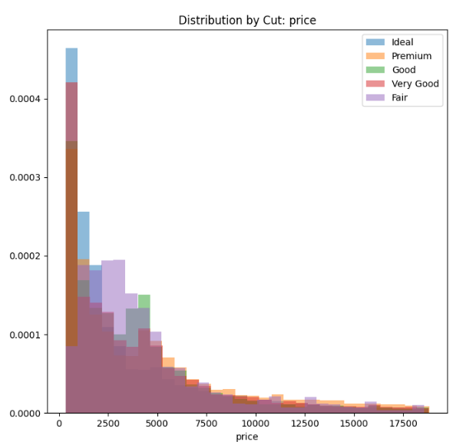

Slide 10
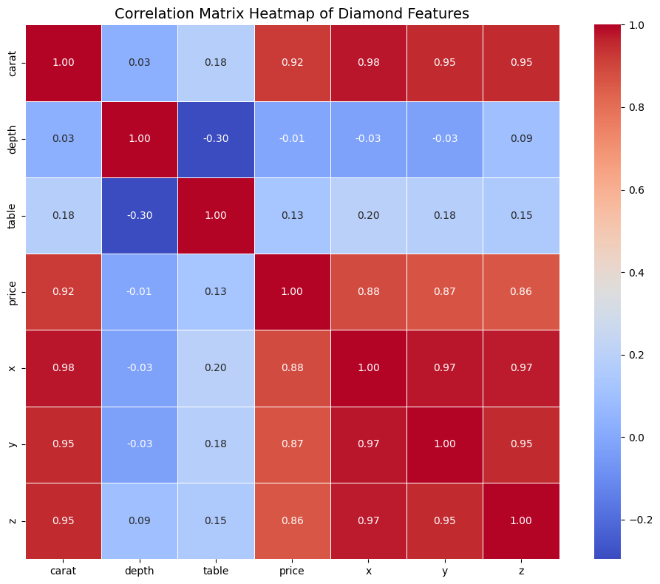

Slide 11
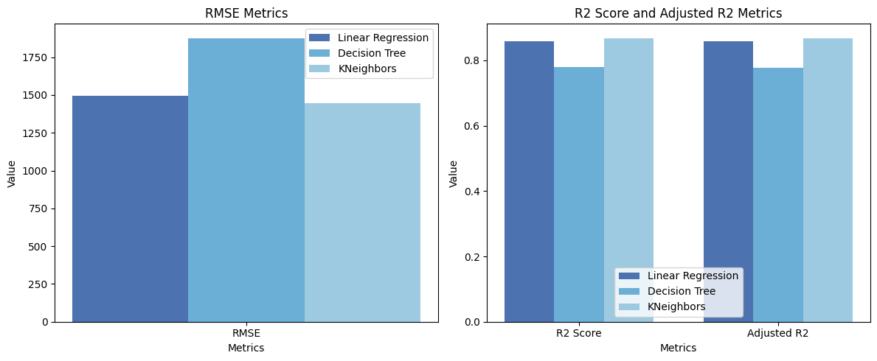
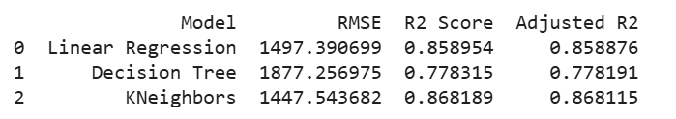
Baseline
MODEL
Linear Regression
Decision Tree
KNN

Slide 12

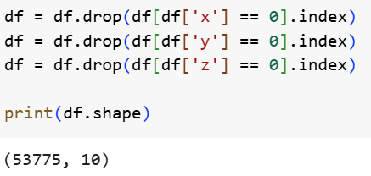
Data exploration
PREPROCESSING IMPACT
Remove the duplicated values
Remove dimentionless diamonds

Slide 13
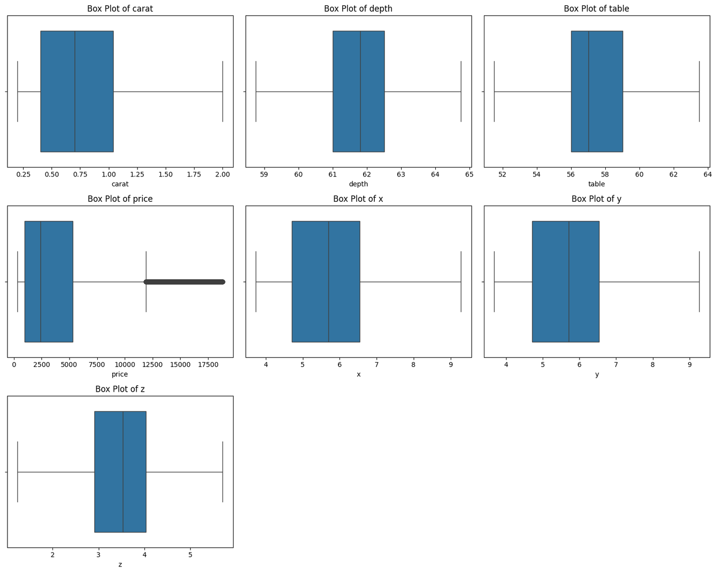
Handle the outliers by Winsorize

Slide 14
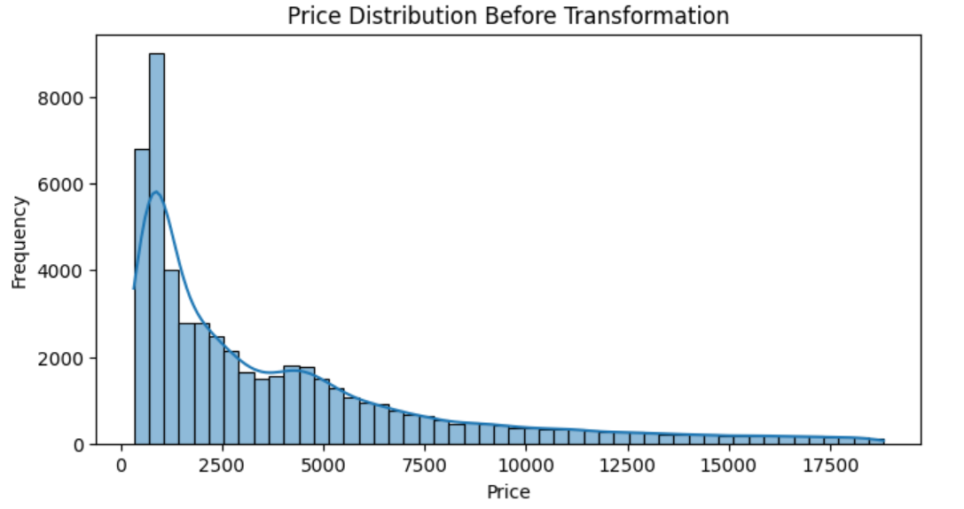
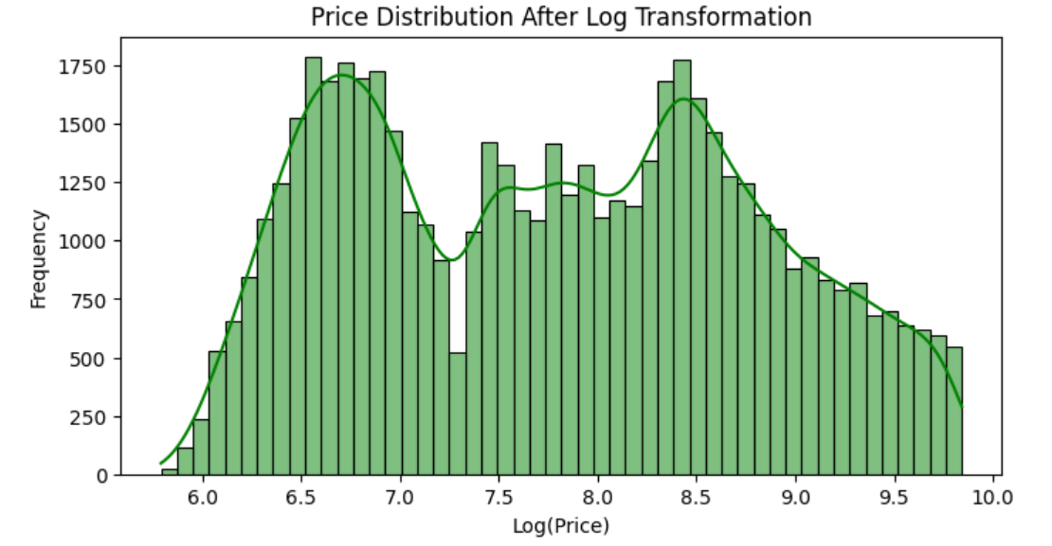
Handle Imbalanced Data
Apply Log Transformation
Heavily Right-Skewed Distribution

Slide 15
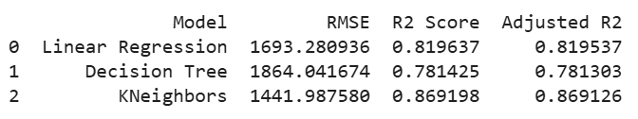
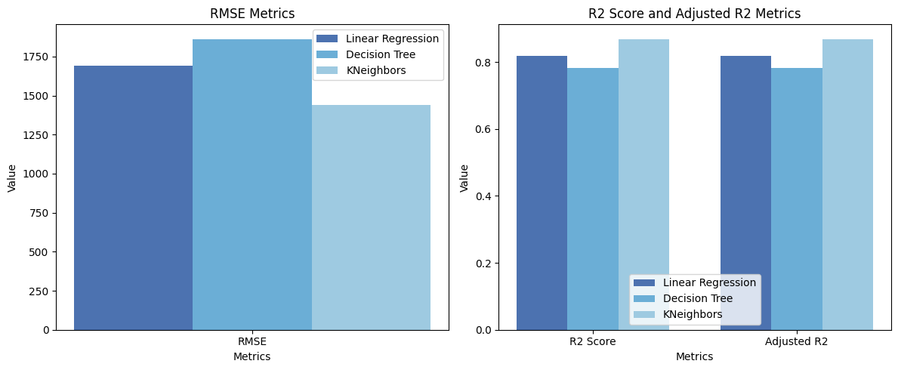
Retrain the Model after Preprocessing

Slide 16
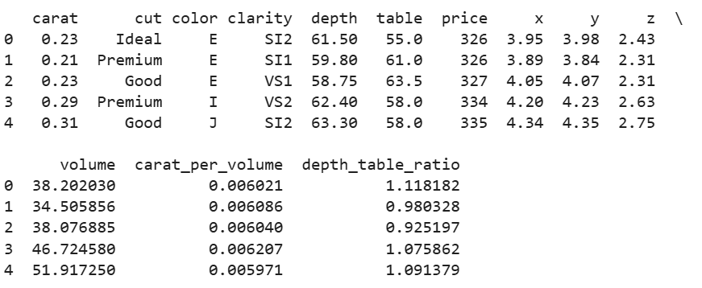
Feature engineering
PREPARATION FOR ML
Volume
Carat per volume
Depth Table Ratio

Slide 17
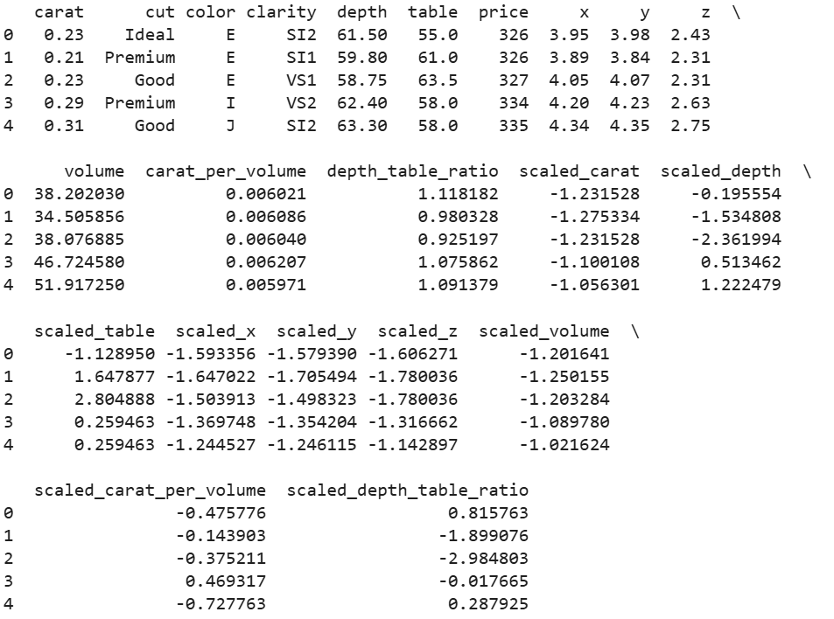
Standardize the variables
Standard Scaler

Slide 18
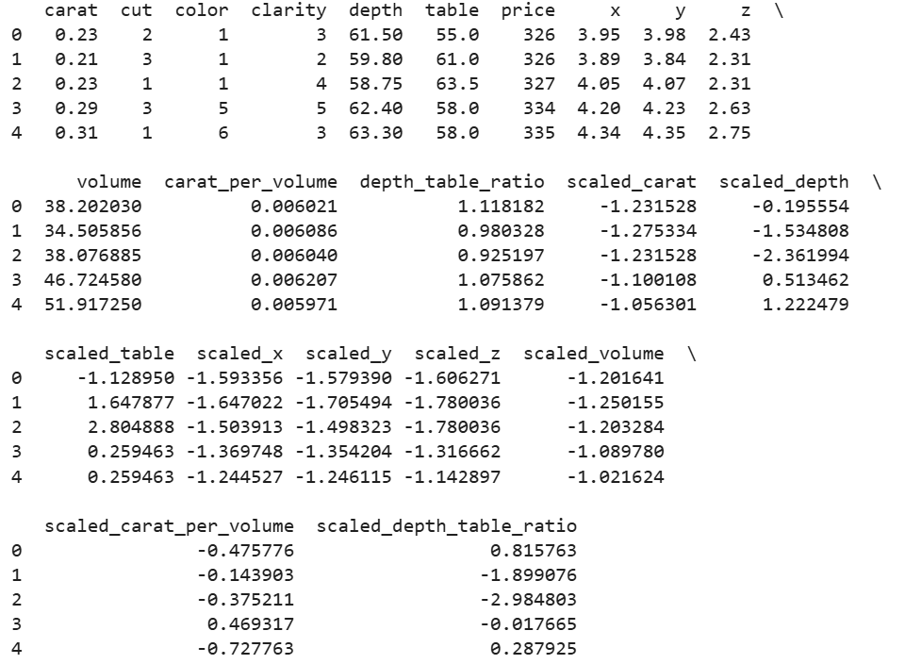
Encoding the variables
Label Encoder
Why?

Slide 19
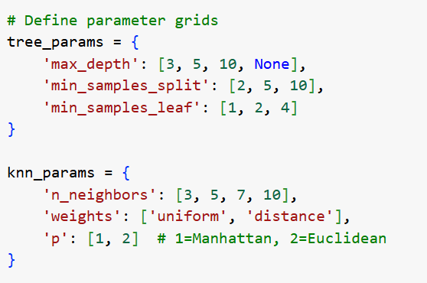
Retrain the Model with Hyperparameter Tuning
Decision Tree
max_depth: prevent overfitting
min_samples_split: makes tree splits more conversative
min_samples_leaf: controls minimum observations per leaf
KNN
n_neighbors: controls prediction flexibility
weights: determines neighbor influence equality
p: distance calculation method
Cross-validation Method: GridSearchCV

Slide 20
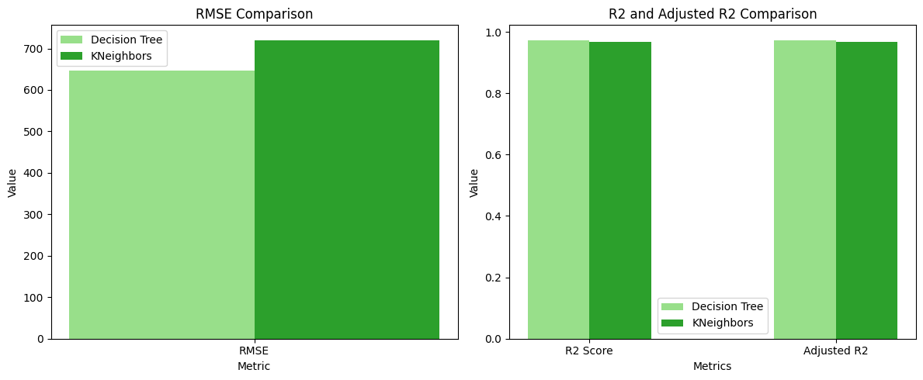
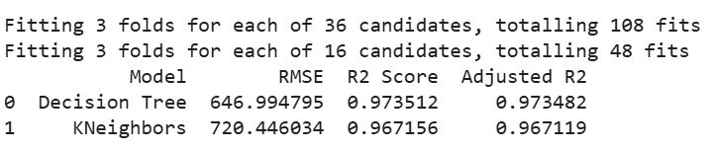

Slide 21
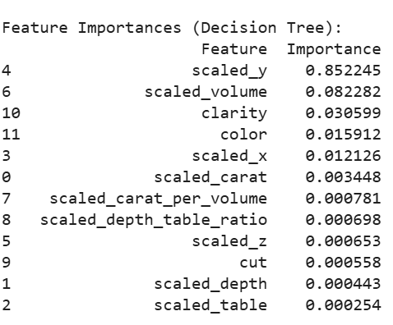
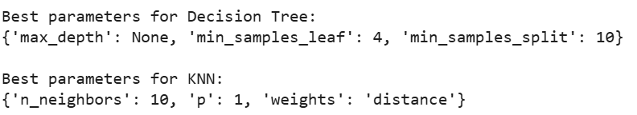
Feature Importances for Decision Tree
Best parameters for each model

Slide 22
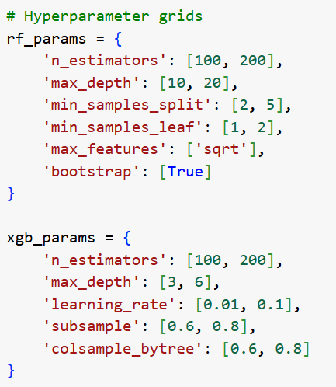
Advanced
REGRESSION MODEL
XGBoost
Random Forest
Cross-validation Method: RandomSearchCV

Slide 23
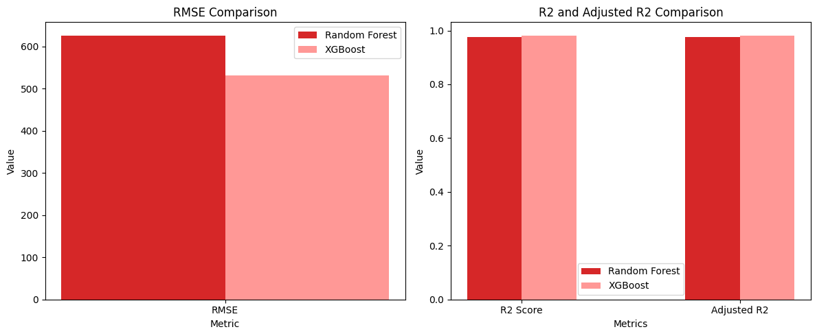
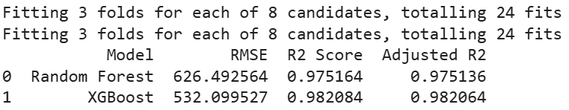

Slide 24
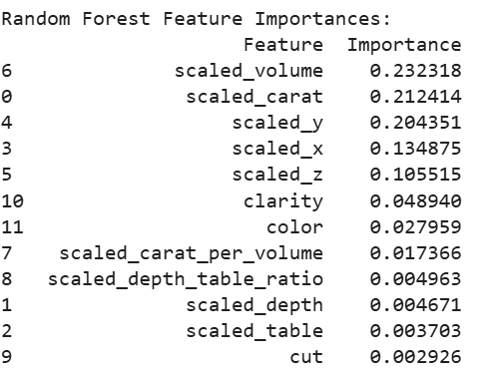
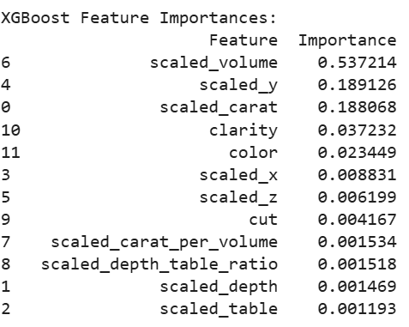
Feature Importances for Random Forest
Feature Importances for XGBoost

Slide 25
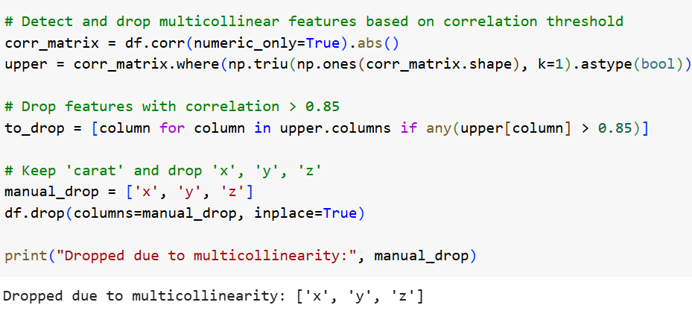
Not handling
MULTI-COLLINEARITY?
Drop the highly correlated features
x
y
z
Why I’m not handle the multi-collinearity at the preprocessing part?
Does it actually elevate the result?

Slide 26
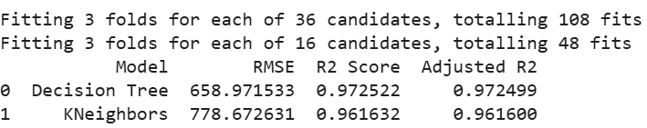
Not handling the multi-collinearity
Handling the multi-collinearity

Slide 27
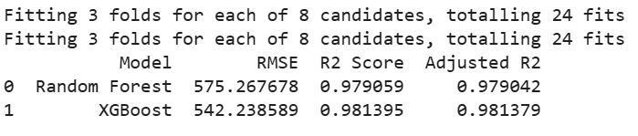
Not handling the multi-collinearity
Handling the multi-collinearity

Slide 28
Challenges,Limitation
& FUTURE WORK
Add more external data sources
Try more both advanced and simple models
Set up a pipe-line to retrain and update the model with new data
Long model training time
Overfitting risk
Skewed target variable

Slide 29
Thank You

